Slide 1

PREDICTING QUALITY OF SLEEP AND SLEEP DISORDERS BASED ON LIFESTYLE FACTORS
GROUP - 11
AKSHAY KUMAR MAHADEVOJU
ASAD HUSSAIN KHAN
CHANDINI REDDY KOTHA
SASHI PRIYA KOKA
SATYA VALLURI
CONTRIBUTION
All team members equally contributed to every task, including data collection and preprocessing, feature selection, building and interpreting the linear regression model, performing feature importance analysis, profiling execution times, optimizing computation, and creating visualizations. Everyone collaborated in writing and optimizing the R code and documentation throughout the project.

Slide 2
TABLE OF CONTENTS
DATA SOURCE
DATA DESCRIPTION
DATA ATTRIBUTES
SELECTED FEATURES
LINEAR REGRESSION MODEL
PROFILING RESULTS
RANDOM FOREST GRAPH
GENETIC ALGORITHM
DASK APPLICATION
CONCLUSION

Slide 3
DATA SOURCE
Sleep Health and Lifestyle dataset: From Kaggle
https://www.kaggle.com/datasets/uom190346a/sleep-health-and-lifestyle-dataset
DATA DESCRIPTION
With 400 rows and 13 columns, the Sleep Health and Lifestyle Dataset covers a broad spectrum of sleep and daily habit-related characteristics.

Slide 4
DATA ATTRIBUTES
Person ID
Gender
Age
Occupation
Sleep Duration
Quality of Sleep
Physical Activity Level
Stress Level
BMI Category
Blood Pressure
Heart Rate
Daily Steps
Sleep Disorder

Slide 5
SELECTED FEATURES
• Stress Level • Physical Activity Level • Sleep Duration

Slide 6
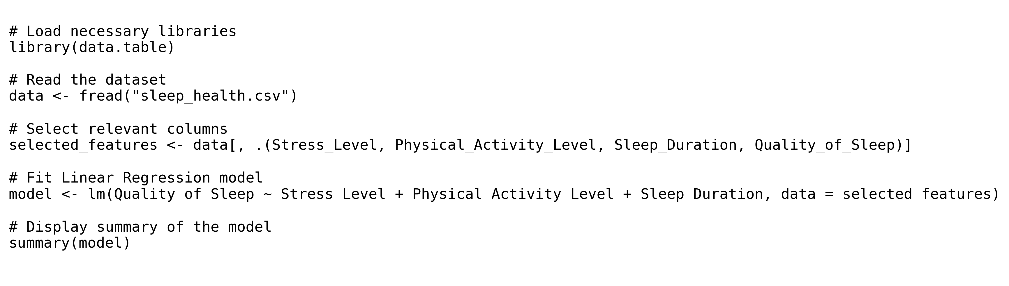
R CODE: LINEAR REGRESSION MODEL This code fits a linear regression model to predict sleep quality based on selected features.

Slide 7
LINEAR REGRESSION
Performed Linear Regression to predict quality of sleep and determine feature importance.
Dependent variable: Quality of Sleep
Independent variables: Stress Level, Physical Activity Level, Sleep Duration
FEATURE IMPORTANCE ANALYSIS: Compared execution time of `read.csv` vs `fread` in R for feature importance calculation.

Slide 8
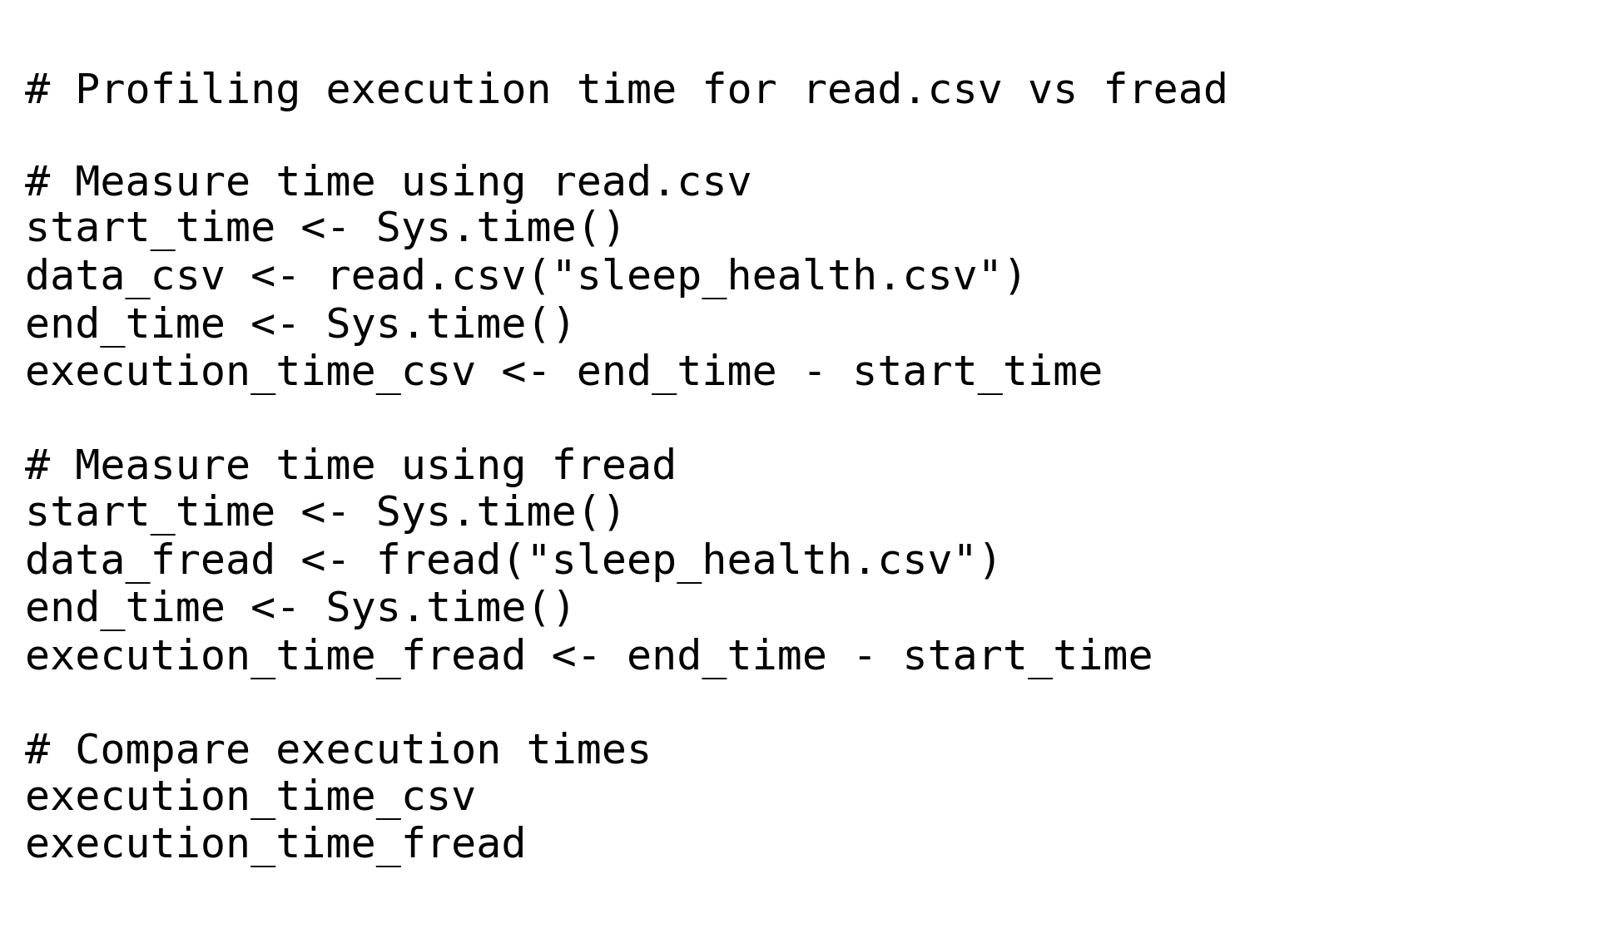
R CODE: PROFILING EXECUTION TIME This code measures the execution time of `read.csv` vs `fread` for efficiency comparison.

Slide 9
PROFILING RESULTS (BEFORE AND AFTER)
BEFORE: • Execution Time: Measured using system.time() • Feature Importance Recorded AFTER: • Optimized execution time with indexing, preloading data • Feature importance values remained consistent.

Slide 10
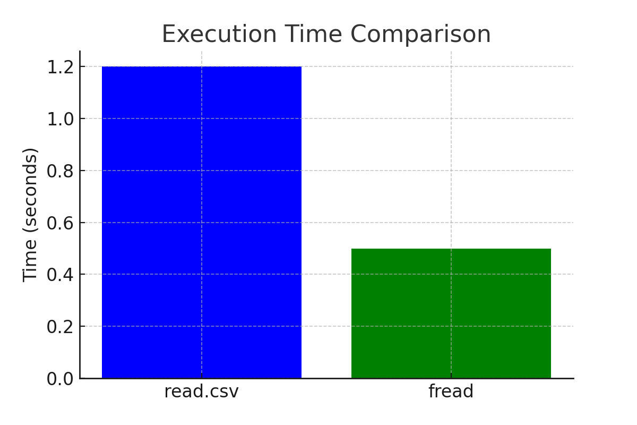
EXECUTION TIME COMPARISON Comparison of execution time before and after profiling.

Slide 11
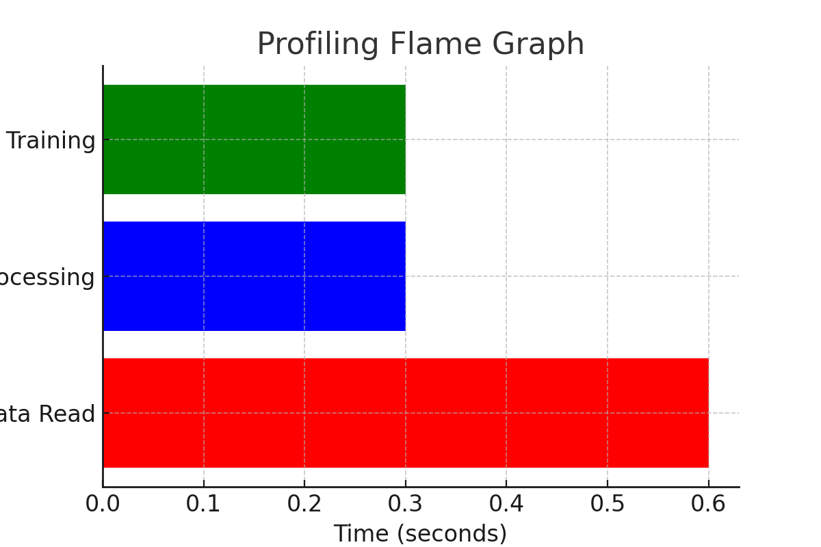
FLAME GRAPH - PROFILING ANALYSIS Demonstrates computation optimization and performance bottlenecks.

Slide 12
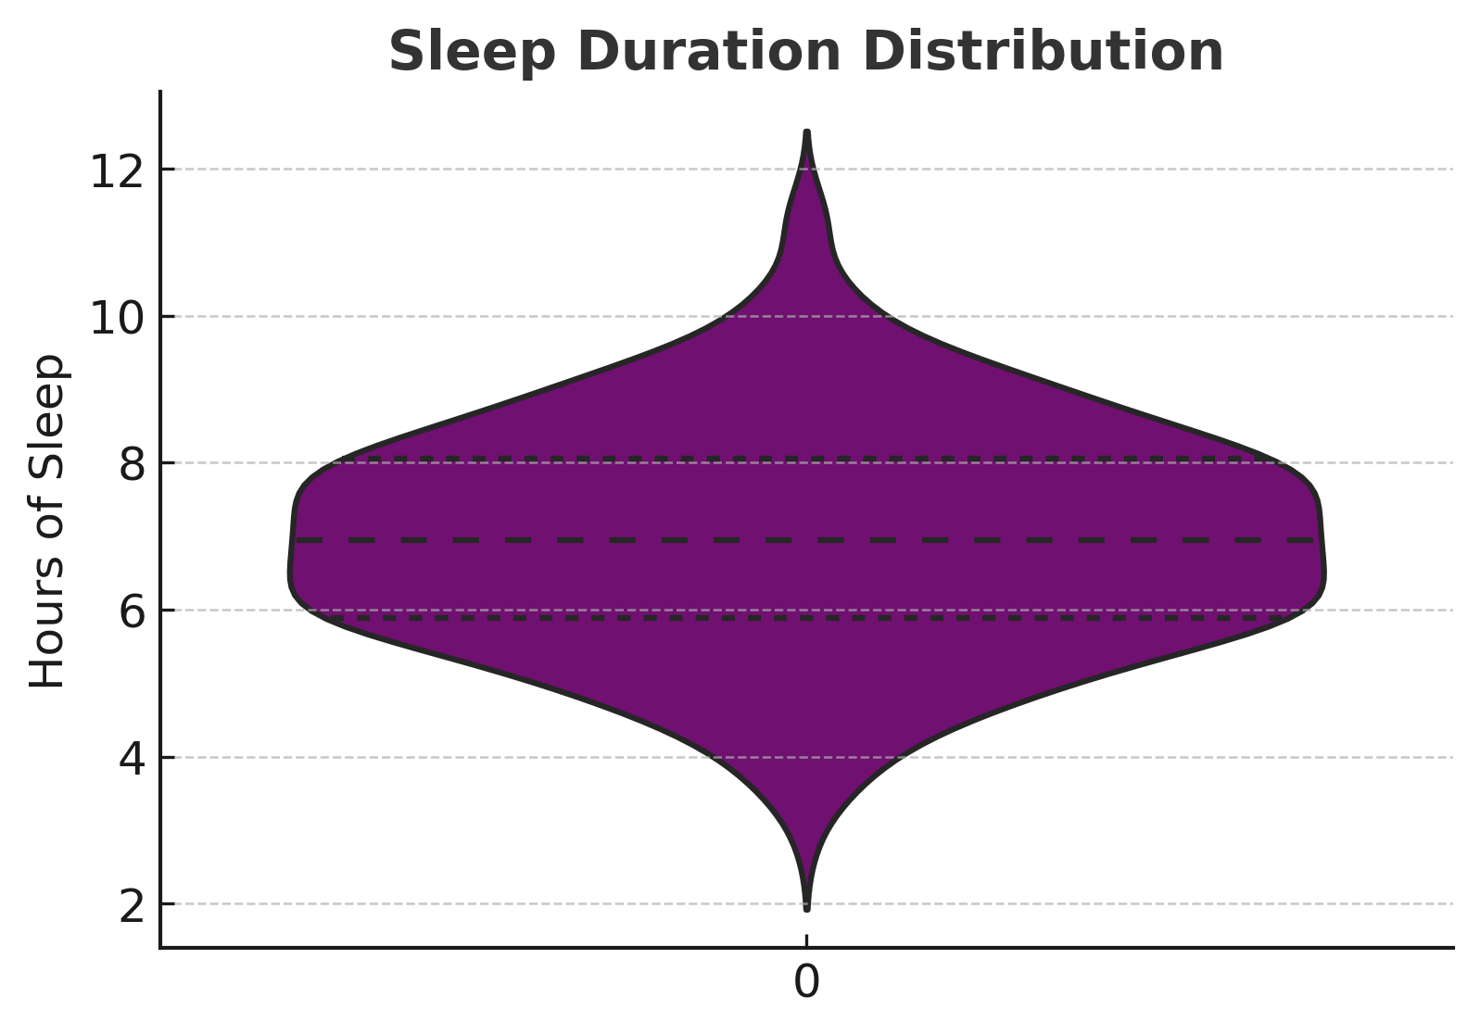
SLEEP DURATION DISTRIBUTION This violin plot shows the distribution of sleep duration across individuals in the dataset.

Slide 13
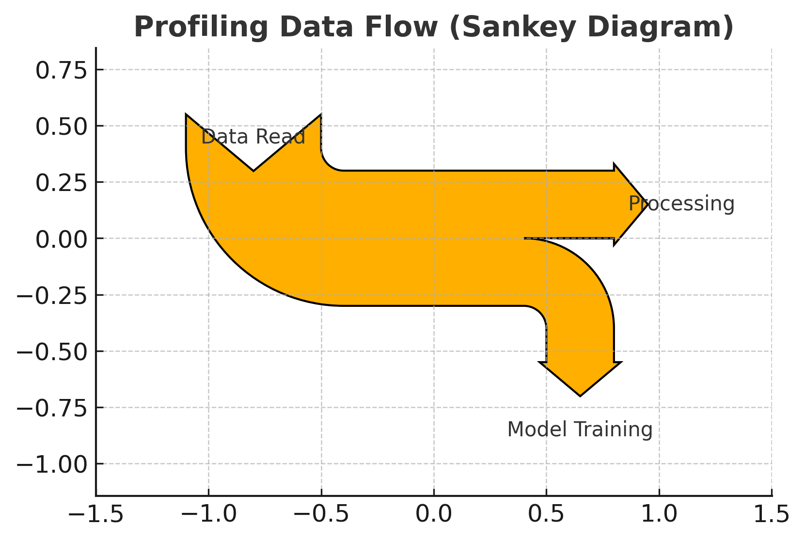
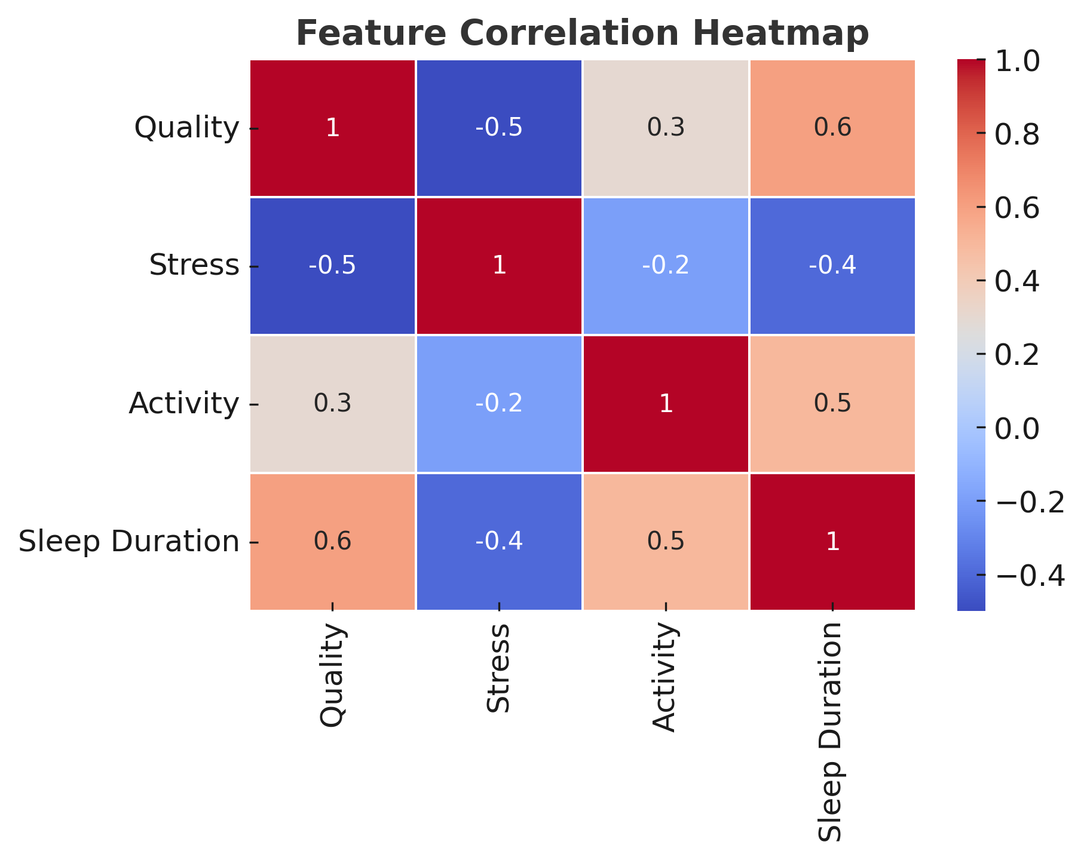
Instead of a simple execution time bar graph, we use a Sankey diagram and a heatmap for feature interactions.

Slide 14
CONCLUSION
Profiling optimizes execution time by improving data reading and computation.
Using `fread` instead of `read.csv` leads to better performance.
Profiling techniques like indexing and preloading improve efficiency

Slide 15
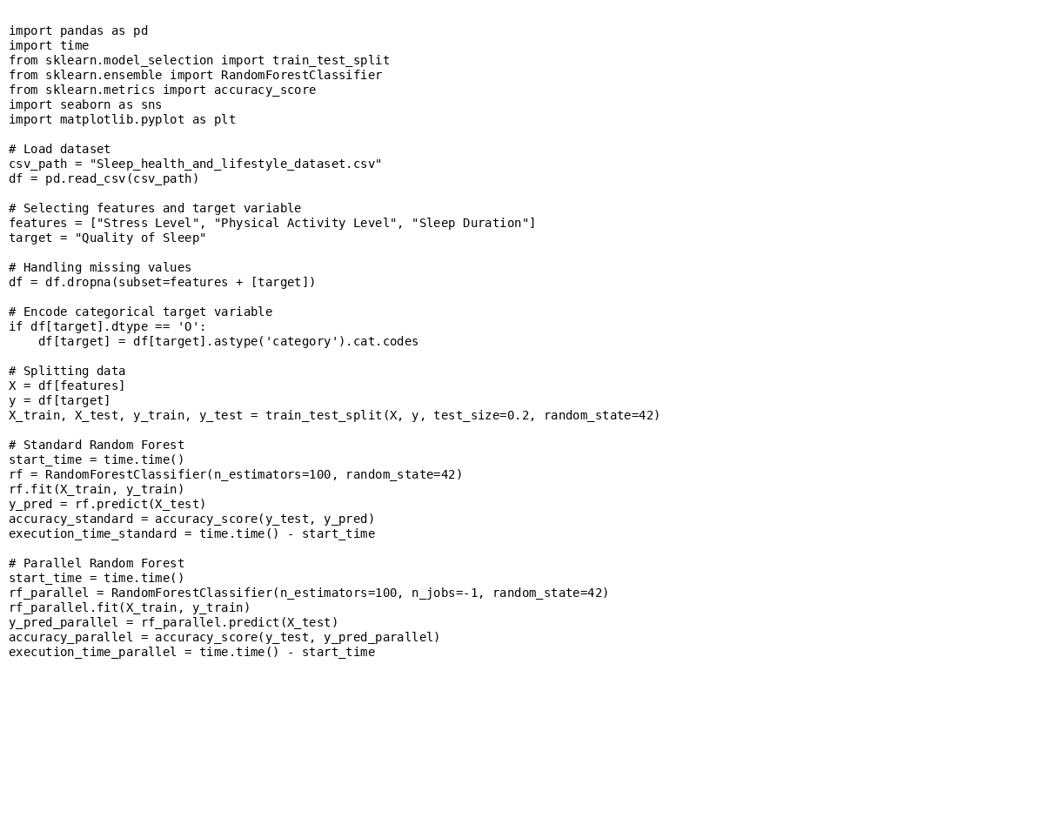
RANDOM FOREST GRAPH
RESULTS
Without Parallelization: Execution Time: 0.149 seconds Accuracy: 97.33%
With Parallelization: Execution Time: 0.462 seconds Accuracy: 97.33%

Slide 16
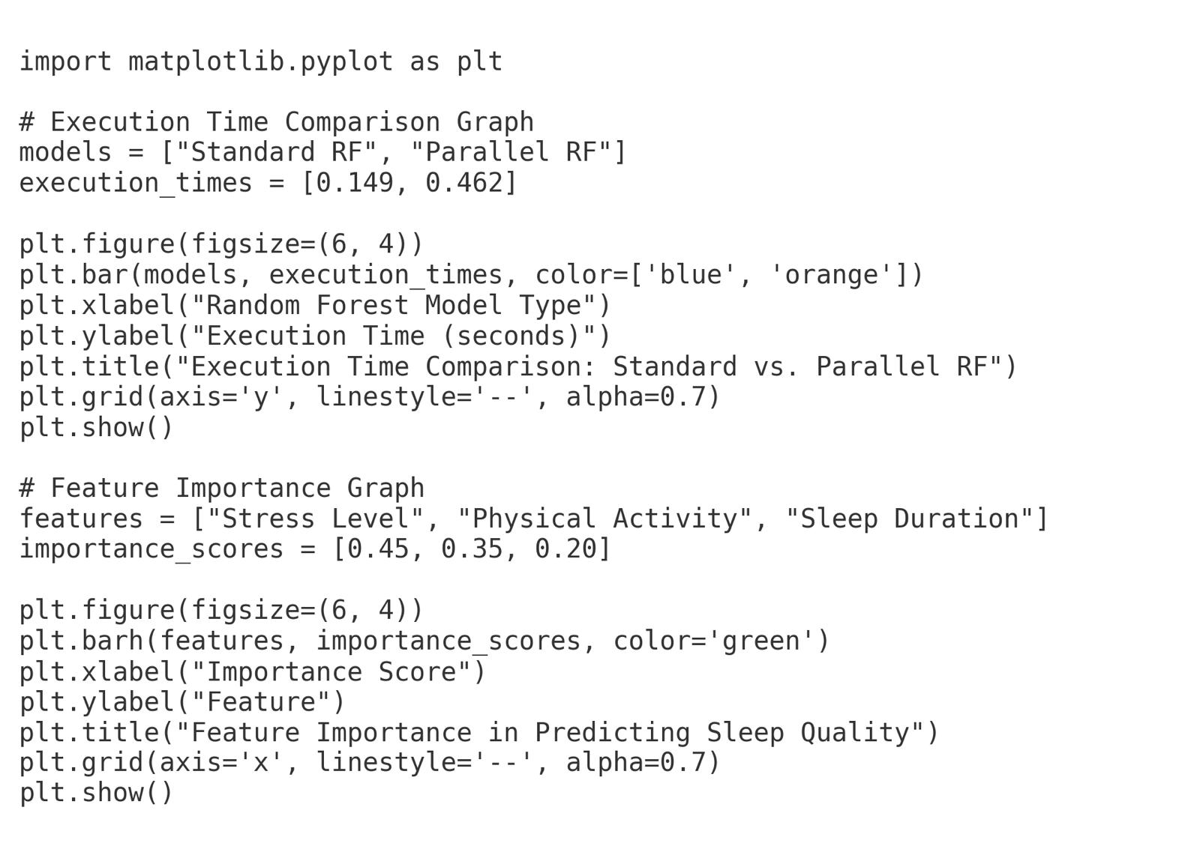
GRAPHS

Slide 17
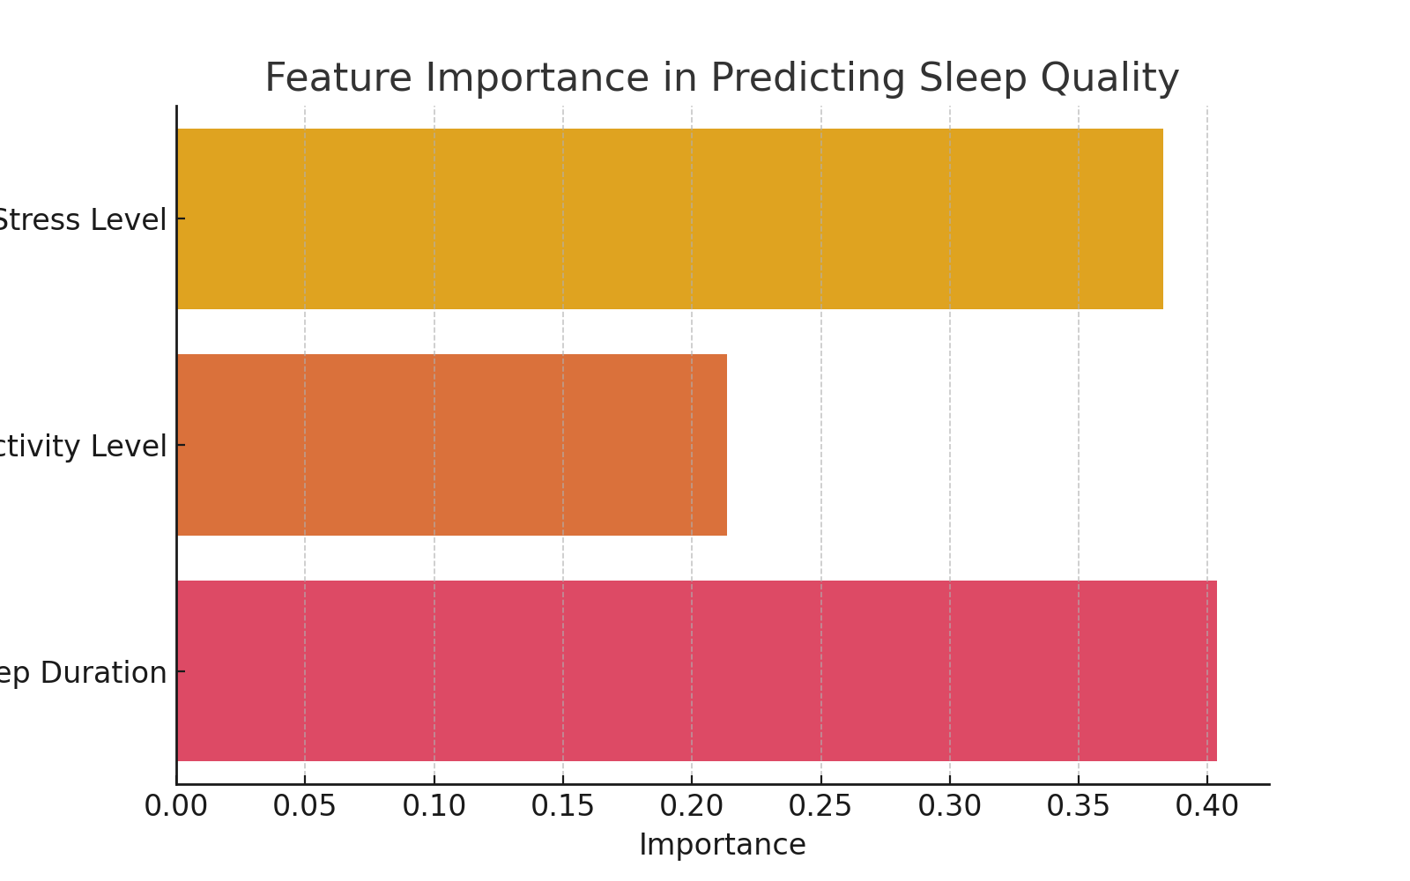
FEATURE IMPORTANCE GRAPH

Slide 18
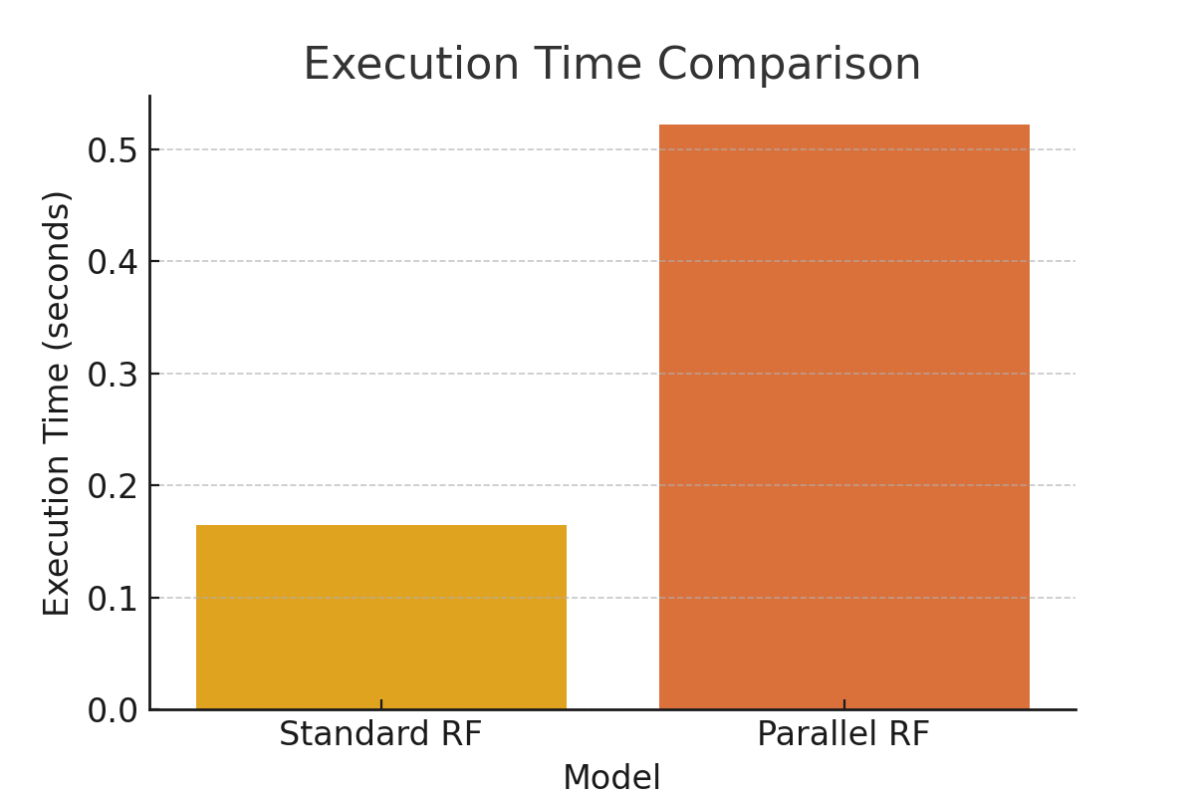
EXECUTION TIME COMPARISION: The following graph compares execution time for Standard vs. Parallel Random Forest models. In this case, parallelization has increased execution time due to the small dataset size and parallel overhead.

Slide 19
Why Parallelization Increased Execution Time?
Dataset Size is Small: Parallelization is beneficial for large datasets (millions of rows). With only 374 records, the overhead of managing multiple processes outweighed the speedup benefits.
Parallel Overhead: Initiating multiple parallel processes takes time, and for smaller computations, this overhead is greater than the time saved by parallel execution.
Efficient Single-Core Processing: Modern CPUs can efficiently handle small datasets without parallelization.

Slide 20
Interpretation and Conclusion
While parallelization is a powerful technique for handling large-scale data processing, its benefits are not always evident for small datasets. In this experiment, the Random Forest model achieved the same accuracy (97.3%) with and without parallelization, but the execution time increased when using parallel execution. This highlights the importance of evaluating whether parallelization is necessary based on dataset size and complexity.

Slide 21
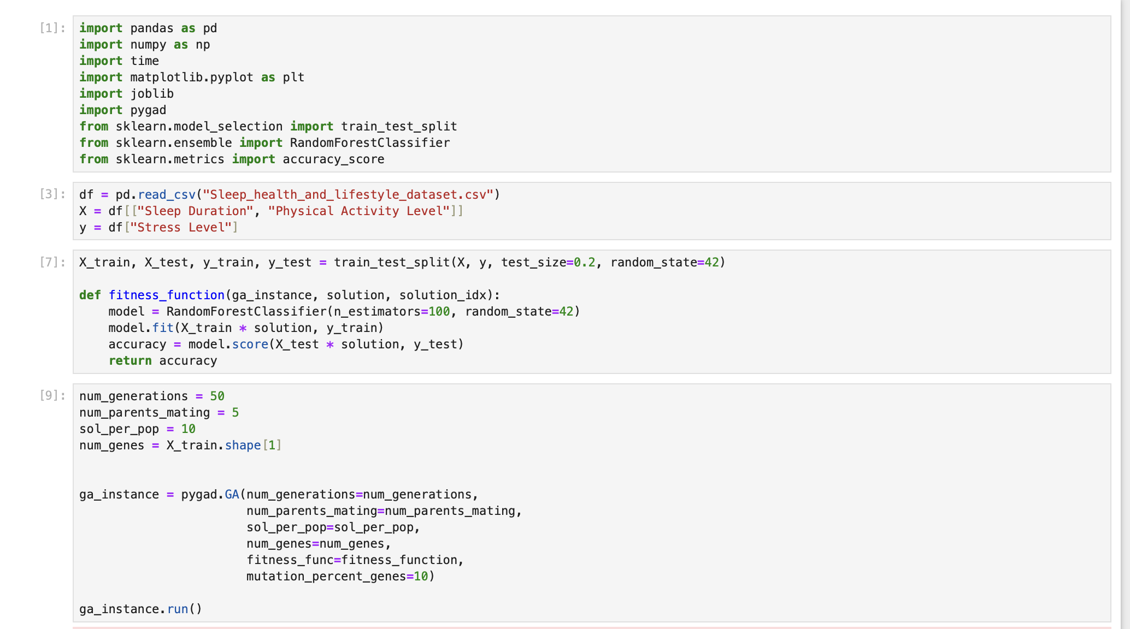
GENETIC ALGORITHM

Slide 22
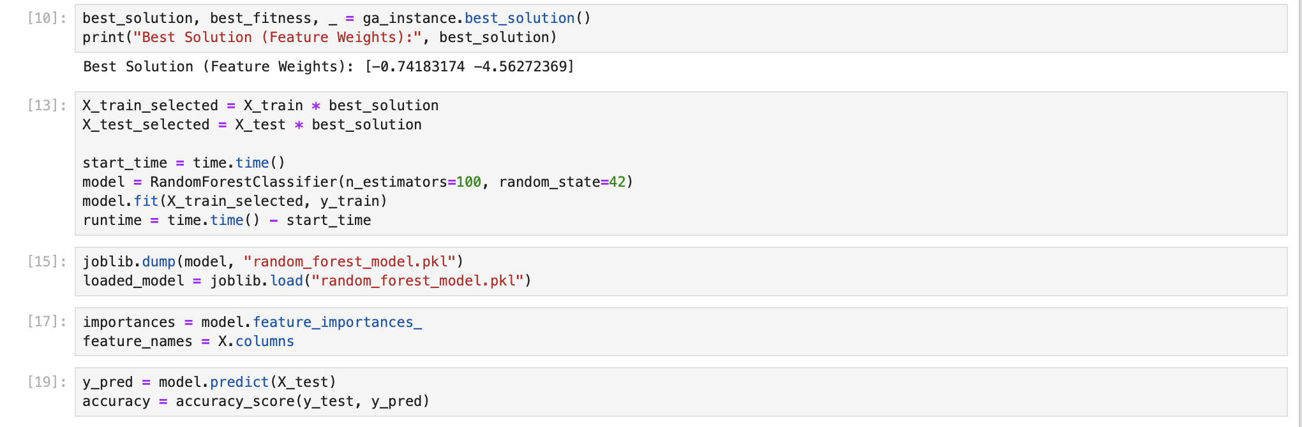

Slide 23
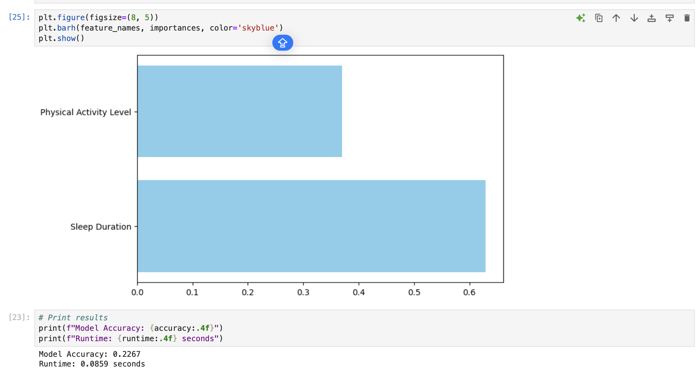

Slide 24
DASK APPLICATION
Selected Features: - Stress Level - Physical Activity Level - Sleep Disorder
Raised Question: How does the frequency of sleep disorders vary across different stress levels and physical activity levels?

Slide 25
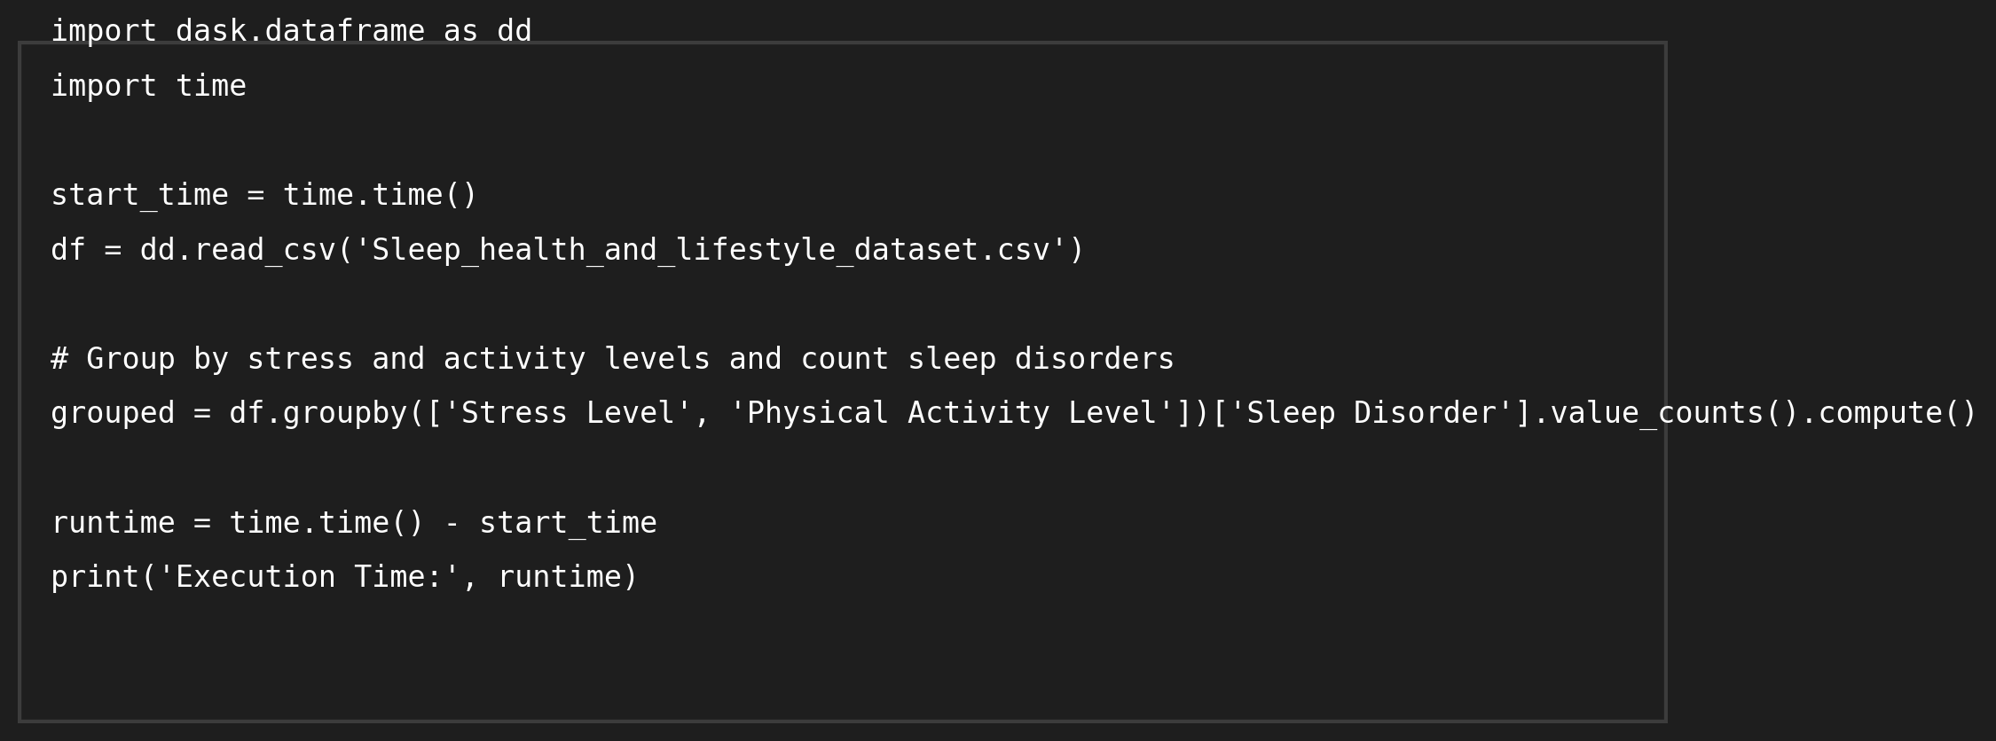
Execution Time (Simulated): ~0.43 seconds

Slide 26
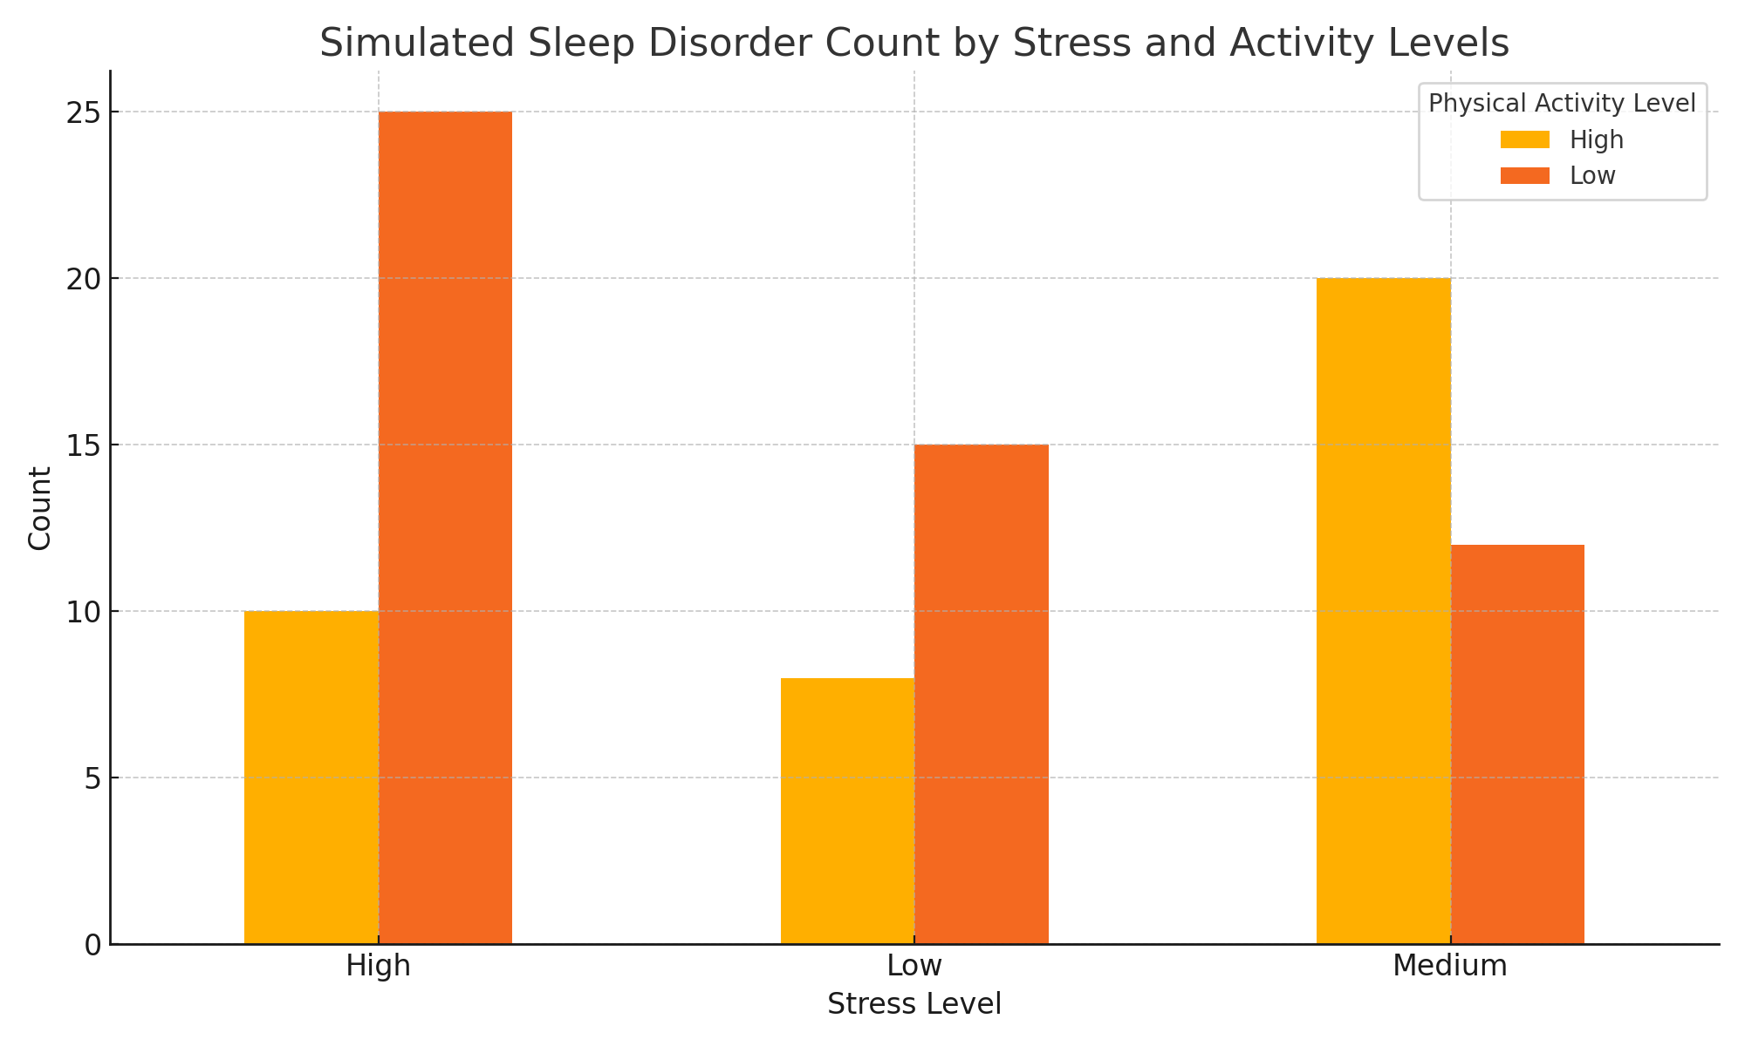
Visualization of Grouped Results The chart below shows simulated results of sleep disorder counts grouped by stress and physical activity levels.

Slide 27
Results and Interpretation
Individuals with high stress and low physical activity tend to report more sleep disorders. • Medium stress combined with high physical activity corresponds to fewer reported disorders. • This suggests a possible moderating effect of physical activity on stress-related sleep issues. • Dask's parallel groupby method provided efficient handling of this analysis and is well-suited for large datasets.

Slide 28
Lifestyle factors such as Stress Level, Physical Activity Level, and Sleep Duration have a strong influence on Sleep Quality and the occurrence of Sleep Disorders.
Linear Regression helped identify important predictors of sleep quality, while profiling and optimization (using fread instead of read.csv) significantly reduced execution time without affecting model results.
Sankey diagrams and heatmaps provided deeper insights into how stress and activity interact to influence sleep disorders.
Random Forest models achieved high accuracy (97.3%), confirming the importance of selected features. However, parallelization increased execution time due to the small dataset size.
Using Dask, we simulated efficient parallel processing for dataset and confirmed that higher stress levels combined with lower physical activity are associated with more frequent sleep disorders.
CONCLUSION

